Slide 1
My Measurement and Ratio
Interactive Notebook
Name
Class
Term 3 Semester 2

Slide 2
Contents
Formula Page
Page
Date
Description
2
3

Slide 3
Tasks
24
7
30
Essential Question
Questions
Notes
Summary
16
17

Slide 4
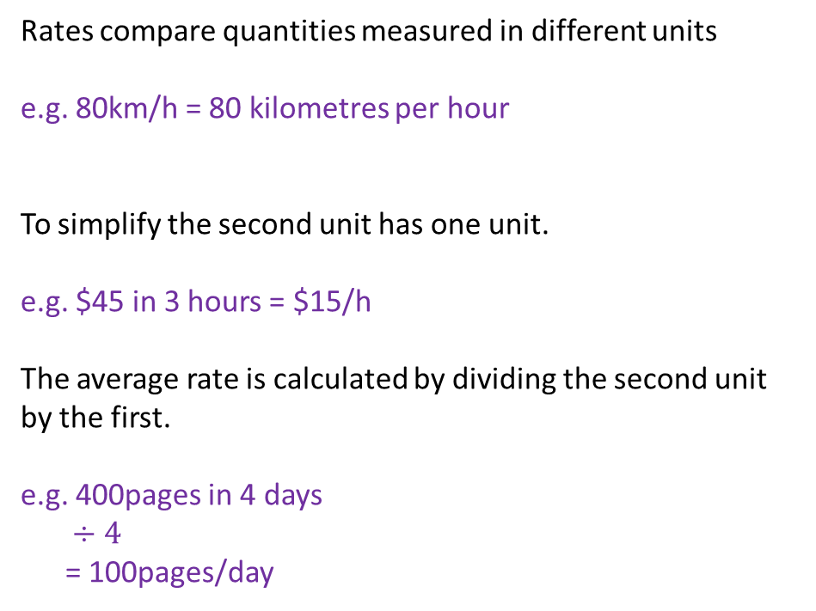
24
7
30
Date
Rates
EQ – How are rates and ratios related?
Rates compare quantities measured in different units
e.g. 80km/h = 80 kilometres per hour
To simplify the second unit has one unit.
e.g. $45 in 3 hours = $15/h
The average rate is calculated by dividing the second unit by the first.
e.g. 400pages in 4 days
$÷4$
= 100pages/day
17

Slide 5
Notes Review
24, 7 ,30
Date
Title
Essential question
Notes complete
Notes complete with colour and diagrams
Questions completed
Contents page filed in
Formula page filled in

